Slide 1

DATA ANALYTICS PROJECT Home credit default risk prediction
Swarupa vijaykumar – PES1UG19CS533
Suvigya Jain – PES1UG19SCS529
Supreeth G kurpad – PES1UG19CS520
Kishan Murthy – PES1UG19CS221

Slide 2
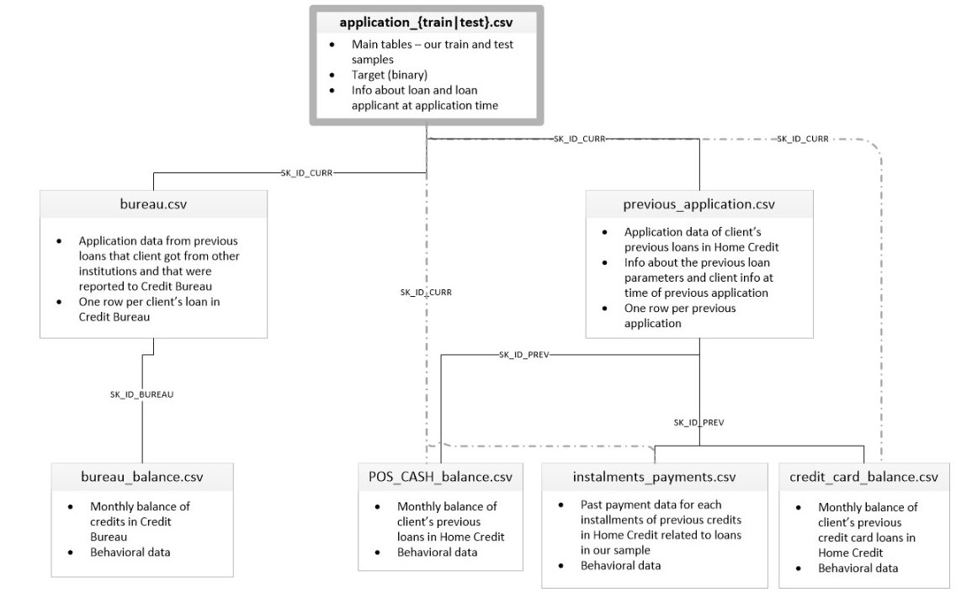
PROBLEM STATEMENT AND DATASET
Prediction of credit default risk – predicting which of the users are more likely to default loans
Many people don’t have sufficient credit histories, hence do not get loans or are taken advantage by untrustworthy lenders.
Hence we use other information about the user like teleco and transaction information to predict payment abilities.
The dataset used was a part of a Kaggle competition organised by Home Credit Group called – Home Credit Default Risk.
The dataset consists of 8 tables with about 3 lakh entries.

Slide 3
WHY IS OUR SOLUTION USEFUL
All the solutions submitted to the competition including the winning solution took a lot of training time – 3 days
This train time increases exponentially with more data.
In order to add more information about a person (more features/attributes), need to retrain whole model again
Our approach reduces train time to 3 hours with trade off of some accuracy.
Supports adding extra features without retraining whole dataset.
Scalable to large data as models can be trained in parallel.

Slide 4
APPROACH
Feature engineering was most important, so added new features to tables using aggregates like min,max,median etc.
Missing data more than 70% was dropped, other values were imputed using median
Model stacking – Type of ensemble model technique where separate models are trained on different features of the dataset and its output is used an input to model at next level.
Level 0 model used was lightGBM, level 1 model was a simple artificial neural network with 1 hidden layer of 6 neurons.
Class imbalance was managed by adding weights to the different classes during model training.
Overfitting avoided by l1, l2 regularisation, setting max depth of tree to 6.

Slide 5
EVALUATION OF SOLUTION
Used ROCAUC metrics
Dataset is highly imbalanced and ROCAUC is insensitive to imbalanced data
Evaluation metric used in competition
ROC – sensitivity vs 1-specificity
AUC – area under ROC curve
We care equally about positive and negative classes in dataset. Don’t want a person to be wrongly labelled.

Slide 6
INTERESTING LEARNINGS AND CONTRIBUTIONS BY TEAM
Feature engineering might be more important that the whole model building itself
Realised that sometimes adding more features is beneficial than removing and reducing dimensions.
Member contributions
Swarupa – PES1UG19CS533 – Level 0 model building and training, final report
Suvigya – PES1UG19SCS529 - Level 1 model building and training, ensemble architecture
Supreeth – PES1UG19CS520 – Feature extraction of POS, credit balance, main tables, EDA
Kishan – PES1UG19CS221 – Feature extraction of remaining tables

Slide 7
THANK YOU

